Slide 1

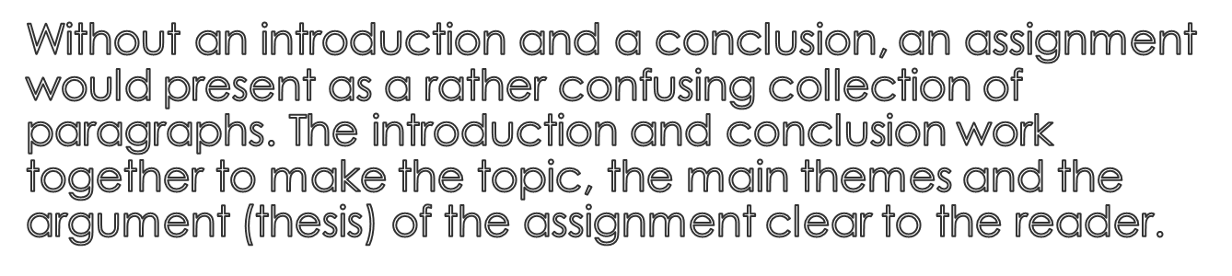

Slide 2

Discuss:
What is the function of an introduction?
What information should it contain?
How can you organise an introduction?

Slide 3

An introduction does the following:
It announces the general topic of the assignment by giving some background on the subject being discussed
It sometimes restates the question
It can provide definitions of key terminology
It states the main themes and what order they will be discussed
It tells the reader what the author will argue (thesis)
An introduction acts as a kind of plan or blueprint of the assignment content
It is usually about 5-10% of the word count

Slide 4

States the importance / significance of topic area / general background statement mentioning topic – eg.‘The industrial revolution has had a huge impact on how we live our lives today.’
Introduces the different sections and themes (paragraphs) of the essay – eg.‘Firstly the essay will discuss… then the essay will look at… finally it will consider…’
Thesis statement / what the essay will argue – eg.‘The essay will argue that…’
An introduction has a ‘general’ to ‘specific’ structure moving from general background to mentioning specific themes/argument.

Slide 5

General background
Specific content (eg. Themes and thesis statement)

Slide 6

Discuss:
What is a conclusion used for?
What information should it contain?
What should a conclusion not contain?
How can you organise the content of your conclusion?
What is the approximate word count?

Slide 7

The conclusion is the final section of an assignment. Its function is to summarise and bring the discussion to a close. A conclusion usually does the following:
Restates the thesis / main argument (using different words)
Summarises the argument and main themes
Allows the author to emphasise and clarify key claims and assertions
States why the discussion is important or significant
Suggests possible future developments in the field

Slide 8
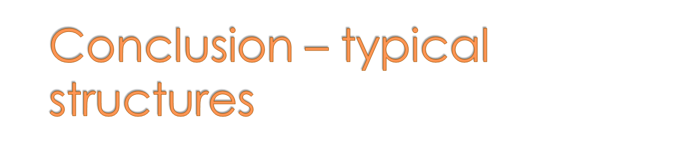
Restatement of thesis – ‘This essay has argued that…’
Summary – ‘The essay has discussed/explored (the theme of)… and… and found that…’
Significance – ‘The essay has demonstrated that… is extremely important in today’s practice…’
Future developments – ‘In the future there may be a trend towards more… / … may become increasingly/more important in the future /This will probably continue to…/ Perhaps in the future this will…

Slide 9

Specific idea (thesis statement)
General ideas (possibilities in the future)

Slide 10

Introductions use ‘will’ future form to indicate intention – This essay will examine/discuss/look at… - What other tenses are used in the example?
Conclusions use present perfect to discuss what an essay has covered – This essay has discussed the advantages and disadvantages of… - What verb forms are used to speculate about the future?

Slide 11

How will you structure the introduction for your current assignment/written work? What content do you need to include?
How will you structure your conclusion? Will you mention speculation on future development in your subject area? What will you say?

